Slide 1
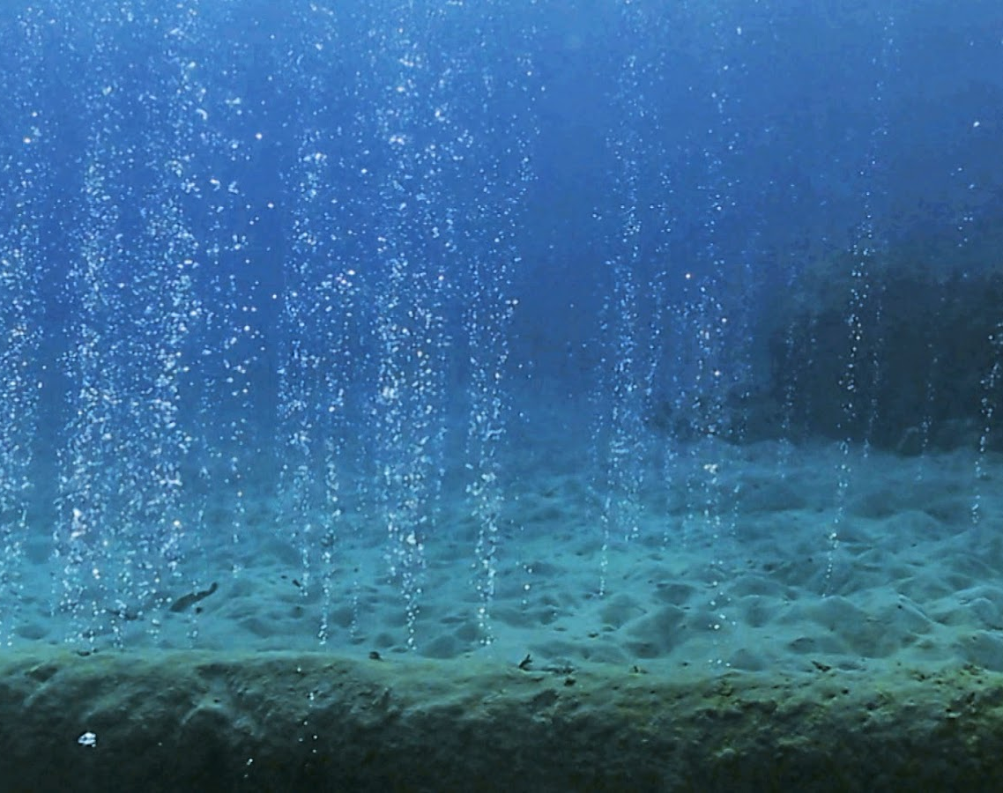


Dielectrophoretic Characterization of Micron-Sized Mineral Particles
Presented By: Ethan Nicholas Johnson
Mentor: Hilairy Ellen Hartnett, Ph.D.

Slide 2
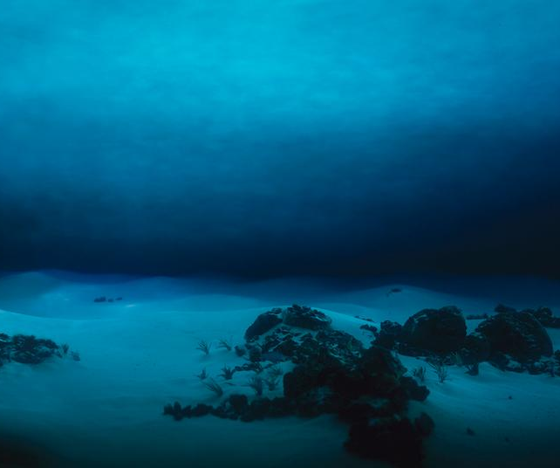
Overview
Novel analytical technique for minerals
Seafloor carbon preservation
Extensibility
Notes:
Notes:
In this research, a method known as dielectrophoresis, or DEP, is proposed as a technique for analyzing the properties of geological materials, particularly marine sediments in this case. Specifically, we want to know what this tool can tell us about how carbon gets preserved in deep sea sediments, a process which is still poorly understood mechanistically. Understanding this mechanism has implications for developing strategies for carbon sequestration on Earth and can also help us understand biosignature preservation on a planetary scale. This technique has never been used to characterize geological materials, and its successful deployment could show that the approach is extensible to other sediments, quite possibly including astromaterials.

Slide 3
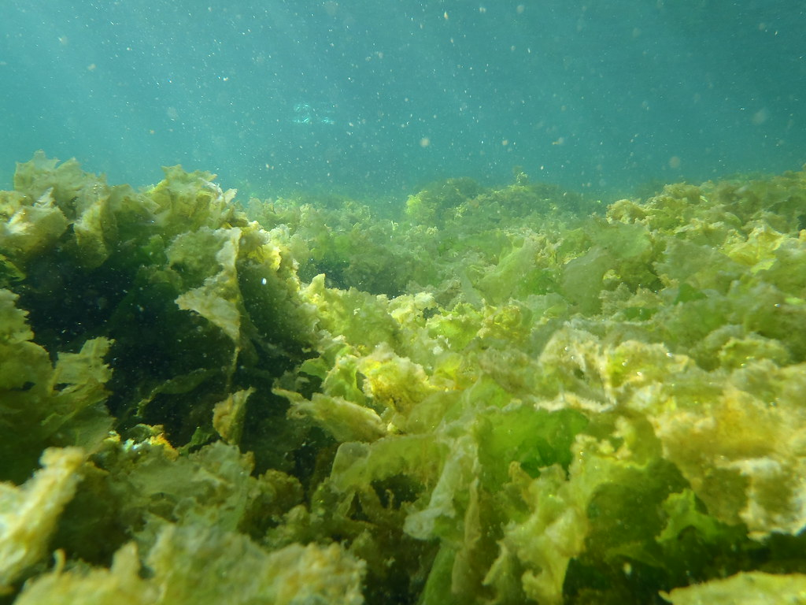
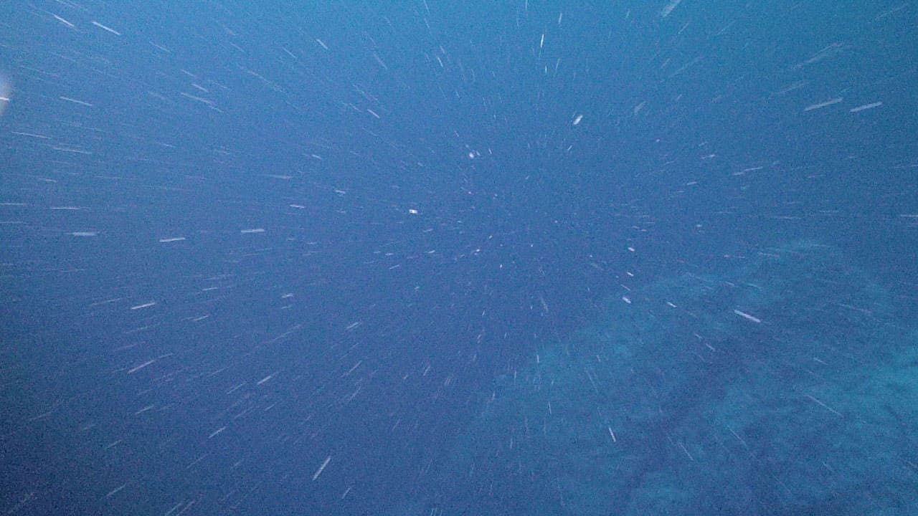





Process of Marine Carbon Burial
CO₂
Primary production
50 Pg C yr⁻¹
Marine snow
Export production
5 Pg C yr⁻¹
At the seafloor
0.5 Pg C yr⁻¹
Buried
0.05 Pg C yr⁻¹
Notes:
Notes:
Through photosynthesis, primary producers such as phytoplankton, microalgae, kelp, and seagrasses turn carbon dioxide dissolved in the ocean into organic molecules that they can use. Each year, they fix 50 Pg of carbon. The surface organisms produce waste, get eaten, and/or die naturally, thus becoming part of the food chain.
Animation (most boxes)
Thus, the organic carbon begins its descent through the ocean as marine snow.
Animation (CO₂ arrow)
Most of it is lost along the way because organisms turn it back into carbon dioxide. By the time organic carbon ends its journey by being buried under the seafloor, only 0.05 Pg is left each year. Organisms still want to eat it, yet, against all odds, over millions of years, the seafloor has accumulated and retained 12.5 million Pg of carbon, making it one of the most efficient sinks of carbon we have.
Despite decades of research, we still don’t know what it is about the association between the organic carbon and the mineral structure of the sediments that preserves the carbon so well, preventing it from getting eaten and ending back up as carbon dioxide. This is where DEP comes in.

Slide 4

Dielectrophoresis (DEP)
Direction of electrokinetic flow
Adapted from animation provided by A. K. M. F. K. Rasel.
Notes:
Notes:
DEP is an analytical technique for separating out particles according to their unique electrophysical properties.
The type of DEP used in this research is called g-iDEP, which allows for very fine differentiation of particles. It responds to the size, shape, and composition of the particles. This image represents a microchannel through which particles flow. The different shapes represent particles with different properties. They will move through the medium of suspension, a liquid depicted in blue. The microchannel is studded with “gates” made of insulating material. The gates get narrower as we go down the channel.
When we apply an electric potential across the channel, …
Animation
…it induces a flow towards the negative electrode. Some of the particles move straight through the channel. But due to the increasing electric field gradients caused by the gates, some particles will get “trapped” or “captured” at a gate. Knowing the width of the gate and the voltage applied, we can begin to mathematically determine properties of the particles such as their surface charge, their polarizability, and conductivity.

Slide 5
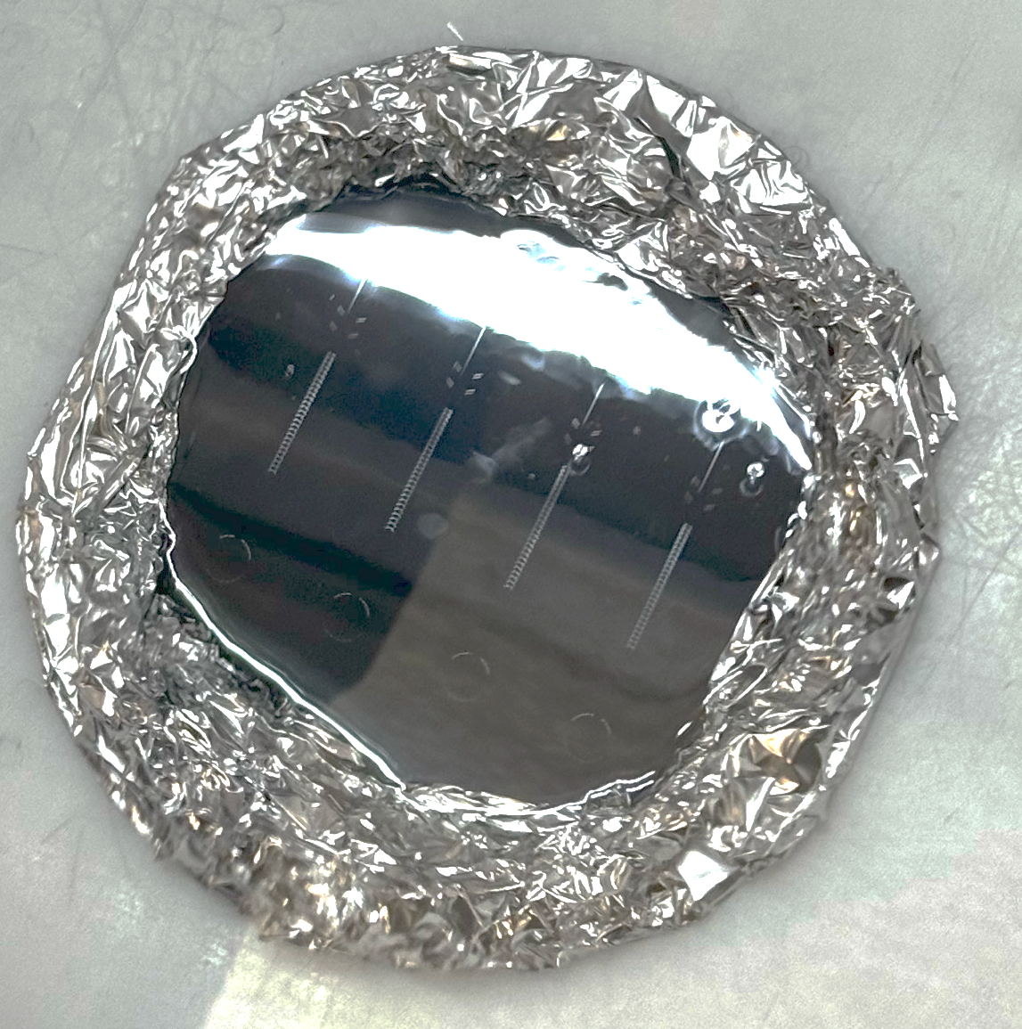
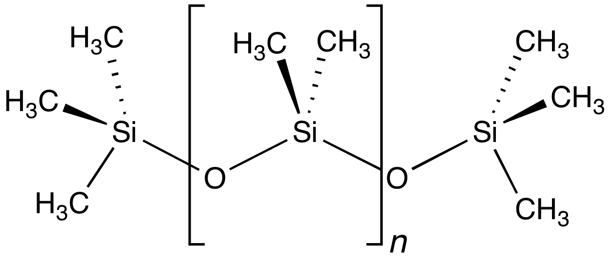
Dielectrophoresis (DEP)
1
27
Inlet
Outlet
1
27
Notes:
Notes:
The g-iDEP device we use is made of a polymer called PDMS. We pour a liquid PDMS mixture onto a silicon mold. You can see four devices created by the mold on the right. Because the channel is microscopic, it is difficult to see, but you can make out the inlet and outlet holes, and probably a pattern in the middle. Those are the gates. This device has 27 gates which get narrower as we go from inlet to outlet.
We use a plasma cleaner to fuse the device to a glass microscope slide so that nothing moves around and all the liquid and sample stays in place.

Slide 6
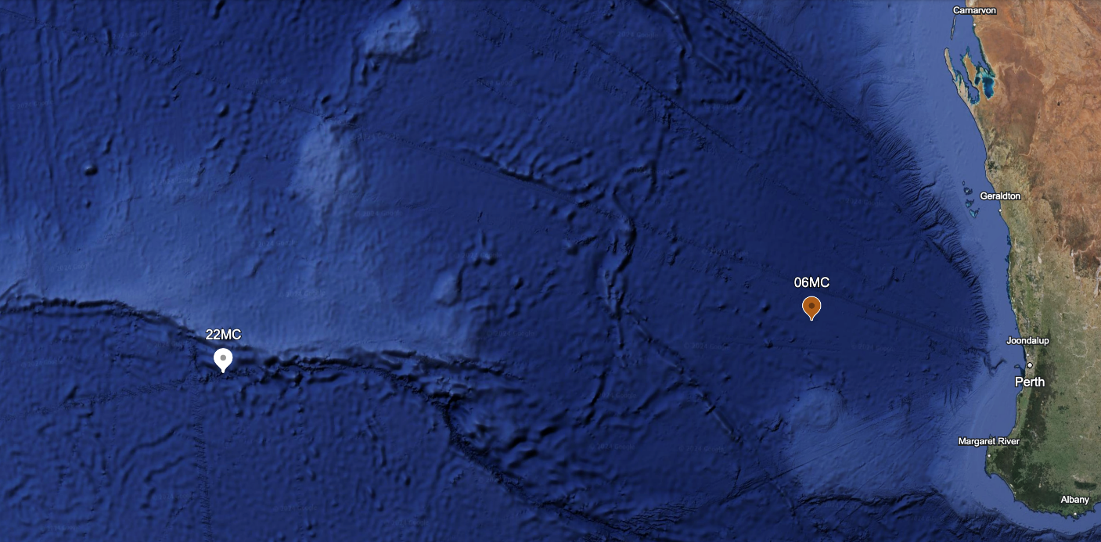
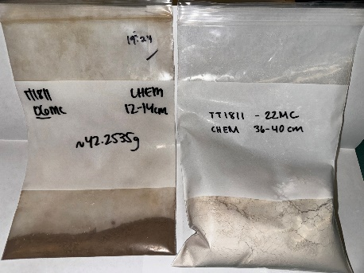
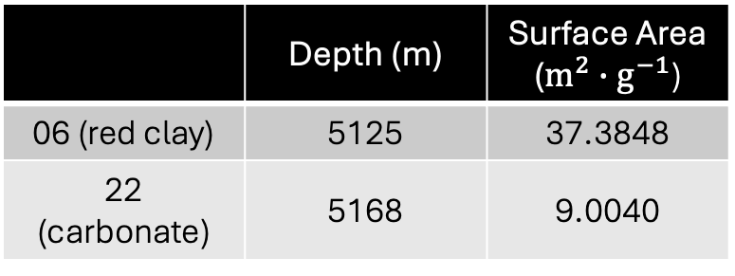
Natural Sediment Samples
 | Depth (m) | Surface Area ($m^{2}∙g^{−1}$)
06 (red clay) | 5125 | 37.3848
22 (carbonate) | 5168 | 9.0040
Notes:
Notes:
Most applications of DEP to date have been for biological applications. Although the primary purpose of our investigation is to examine the differences between sample behavior with and without carbon, we first had to ask if this is feasible. Since g-iDEP has not been done with geological materials before, the very first question we had to answer was “does it work?” Here I will talk a little more about the materials in question.
In this research, we have examined two natural sediment samples obtained from the floor of the Indian Ocean. Furthermore, these were treated to remove organic carbon, resulting in two carbon-free versions of the samples.
The sediments were obtained off the southwestern coast of Australia at a depth of over 5000 m. We performed BET analyses to determine the surface area of these samples. We determined that the surface areas are sufficiently different that distinct behavior should easily be observed under DEP.

Slide 7

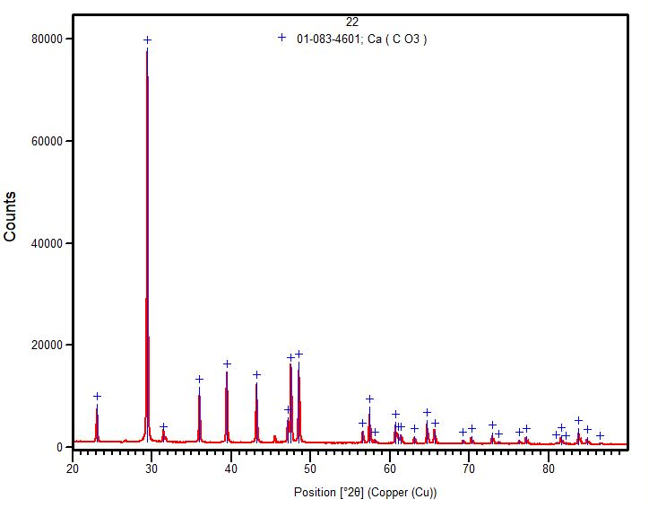
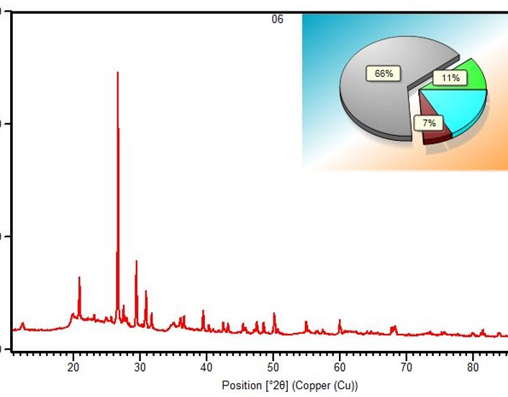
X-ray Diffraction (XRD)
SiO₂
CaCO₃
Al₂Si₂O₅(OH)₄
Notes:
Notes:
Through comparing X-ray diffraction patterns, we determined that the white sample is composed entirely of calcium carbonate. Our red clay, has a more complex mineral composition according to the XRD analysis. It is 66% silicon dioxide, or quartz by mass, but also contains calcium carbonate and other minerals.

Slide 8
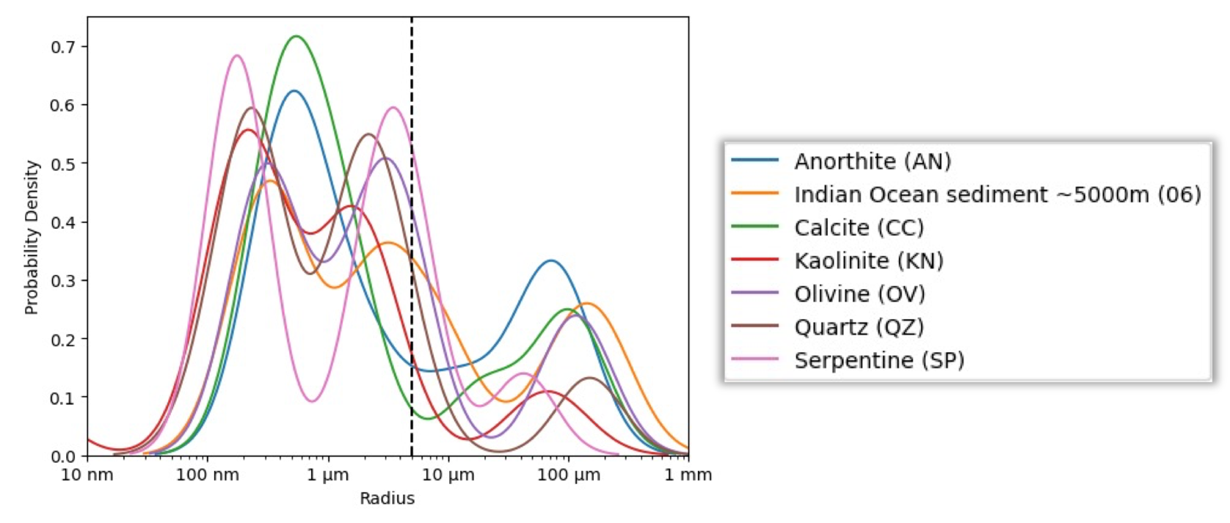
Dynamic Light Scattering (DLS)
Notes:
Notes:
The ideal particle size for our DEP device is less than 5 µm. To determine the exact size distribution of our samples, we used dynamic light scattering (DLS). This figure overlays data from our red clay as well as other samples that we will use in the near future. From the DLS data, we did determine that all these samples had size fractions that were too large for the device, as shown by the peaks in that region.
Animation
However, all samples also had peaks in the ideal size region for our device, meaning that they could still be used although with some caution, as I will discuss soon.

Slide 9
Preparation of Samples
Natural sediments: Air-dried
Crushed and/or sieved to a small size
5 mg/mL suspensions prepared
Carbon-free natural sediment samples: Muffle furnace at 500°C for 4.5 hours
Notes:
Notes:
Moving back a step, I will now describe how the samples were prepared. The natural sediments, since they came directly from an ocean, were air-dried. Next, all samples, both natural and acquired, had to be crushed and/or sieved to a small size. Lastly, sample suspensions were created by adding some amount of sample to test tubes and diluting each to 5 mg/mL with deionized water. The carbon-free natural sediment samples were further prepared by putting some sample in crucibles and burning them in a muffle furnace at 500°C for 4.5 hours. This was presumed to combust any organic carbon on the natural sediments, which was verified with loss on ignition (LOI) data.

Slide 10

Observation and Application of Electric Potential
Example of capture:
3000 V
Notes:
Notes:
To conduct a DEP experiment, we add some buffer solution to the device through its inlet. This is the medium of suspension that the particles will move through. We observe the device under a microscope. We shake a test tube containing a sample suspension using a vortex machine. We wait several seconds so that the larger particles settle to the bottom, and we take out some sample that remains suspended at the top and contains smaller particles that fit in our device. We filter the sample and then introduce it to the device. At this point, we are able to see the particles in the device. We place electrodes at the inlet and outlet holes. Once we turn on the voltage, the particles will begin to move.
Video
Here I have included a demonstration of particle behavior using silica beads. We turn on the voltage, and shortly we see particles congregating around this gate. Hardly any particles make it through. This is the behavior I previously referred to that we call “trapping” or ”capture.” This can give us useful information about the particles.

Slide 11
Can geological materials be tested in a g-iDEP system?
Notes:
Notes:
So now we come to the results. As I mentioned, the first question we set out to answer was “Does this work?” I want to reiterate that this has never been done before. If this doesn’t work, this investigation is over sooner than it started. So let’s find out the answer to that question.

Slide 12

Red clay
Yes!
Notes:
Notes:
We began by testing our red clay.
Video
You might be able to see the particles dancing around the entrance to this gate. This is clear evidence of capture. So does this work? “Yes!” Just knowing that the sediments don’t just go straight through the device, but actually seeing capture is a significant result. We know now that we can certainly test geological materials with g-iDEP. So now that we’ve gotten that out of the way, …

Slide 13
Is there different behavior between samples with organic carbon and samples without organic carbon?
Notes:
Notes:
…our next question is “do samples with organic carbon behave differently in the device than samples without organic carbon?”

Slide 14
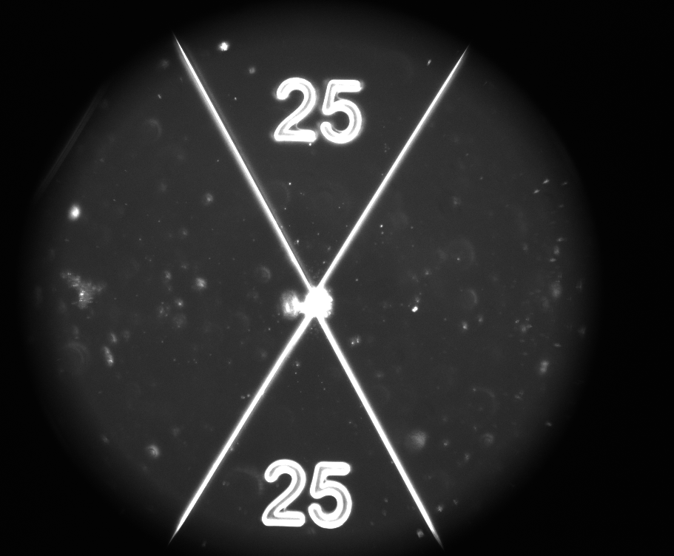
Red clay (carbon-free)
Yes!
Notes:
Notes:
To test this question, we simply tested the carbon-free sample under the same conditions as the natural sample. We expected to see different behavior because we predict that the organic carbon-mineral association alters the electrophysical properties of the sediment.
Animation (gate)
The particles seemed to cluster and they clogged the device at the gate. It is yet to be determined how or if this can be explained by electrophysical properties of the sediment, but it is significant because there is, in fact, different behavior between the sediments, since the sample with carbon did not clog the device. So, to answer this question,
Animation (yes!)
Yes, there is different behavior between samples with carbon and otherwise identical samples without carbon!

Slide 15
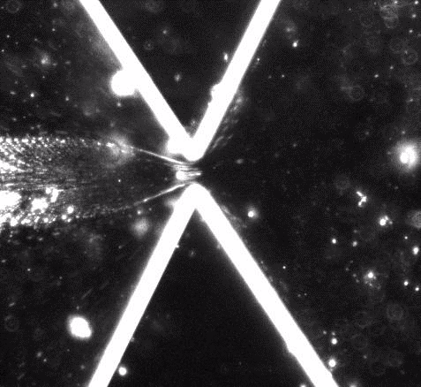

Current Conclusions
With organic carbon
Without organic carbon
Without organic carbon in different buffer
Notes:
Notes:
At the risk of sounding like a broken record, this is the first time anyone has ever tested geological materials in this way. The fact that it succeeded shows that it is possible. This opens the door for anyone with these kind of samples to add this to their arsenal of analytical tools, whether they are testing marine sediments, rocks on land, or even minerals from other planets.
Next, we successfully determined that there is a difference between the behavior of natural sediments with carbon and natural sediments without carbon, although more experiments will be necessary to get to the bottom of why there are differences.
We additionally determined that using a buffer with a higher ionic strength will prevent clustering of sediments. These are all great starting points for upcoming and future research directions.

Slide 16
Next Steps
Red clay with carbon in the same HEPES buffer as red clay (carbon-free)
Pure minerals with different organic coatings
Particles of varying sizes
Different experimental conditions
Notes:
Notes:
The immediate next steps, which we have already started working on, are to test different combinations of buffers and samples. Next, we will test pure mineral samples in the device and test them with different organic coatings. From there, there are a multitude of ways to change conditions to obtain new results, such as testing particles of different sizes, different organic carbon content, media of suspension, and even conditions such as pressure and temperature.

Slide 17



Acknowledgments
Hayes Lab
Mark A. Hayes, Ph.D.
A K M Fazlul Karim Rasel
Hartnett Lab (CaNDy Lab)
Donny Glaser, Ph.D.
Kristen Knappenberger (also of Throop Lab)
Throop Lab
Heather Throop, Ph.D.
Fromme Lab
Manashi Sonowal
Correspondence:
Ethan Johnson
enjohn13@asu.edu
The material contained in this presentation is based upon work supported by a National Aeronautics and Space Administration (NASA) cooperative agreement 80NSSC20M0041. Any opinions, findings, conclusions or recommendations expressed in this material are those of the author and do not necessarily reflect the views of NASA. This work was supported through a NASA grant awarded to the Arizona/NASA Space Grant Consortium.
____________________________________________________
The research described herein is supported by an American Chemical Society (ACS) Petroleum Research Fund (PRF) New Directions grant #65711-ND2 awarded to the principal investigators.

Slide 18
Questions?
Notes:
Anticipated questions:
Q: What did you determine were the electrophysical properties of the sediments?
A: We do not have this information yet. The key to determining these properties is the electrokinetic mobility ratio, or EKMr. The EKMr is defined as the electrokinetic mobility, or µ_{EK} divided by the dielectrophoretic mobility, or µ_{DEP}. With the information we have, we can determine µ_{DEP}, but complementary experiments are required to determine the µ_{EK} and thus complete the missing half of the puzzle.
Q: Why do you use a buffer solution for DEP?
A: The ions in the buffer solution allow it to carry an electric current.
Q: Why do you make the device out of PDMS?
A: PDMS is popular for microfluidic devices because it is transparent, flexible, relatively inexpensive, and easy to work with. Also, as I previously mentioned, most applications of dielectrophoresis to date have involved biological materials. PDMS is biocompatible, meaning that it is not harmful to living things. However, the most important aspect of PDMS in the context of this investigation is that it is an insulating material, which makes it capable of creating the local gradients that are fundamental to gradient insulator-based DEP.
----
Q: How does dynamic light scattering work?
A: In a DLS apparatus, we shine a laser light onto the sample. When the light hits particles, it gets scattered. The instrument monitors the intensity of the scattered light. Smaller particles move faster and will cause more fluctuation in the intensity of the scattered light, whereas larger particles move slower and cause less fluctuation. From this information, we can determine the size distribution of the particles.
Q: How does X-ray diffraction work?
A: With XRD, we direct X-rays at the analyte material. The X-rays bounce off the atoms and interfere with one another, creating a unique pattern. This pattern can then be cross-referenced against known mineral patterns to identify the mineralogy.
Q: How does the plasma cleaner enable the PDMS to bond to the microscope slide?
A: The plasma cleaner uses a high frequency electric field to liberate electrons from oxygen gas in the chamber, putting it in a plasma state. The oxygen then reacts with the structure of PDMS, replacing the methyl groups with hydroxy groups (-OH). This sets the stage for the PDMS device to form strong Si-O-S bonds with the silica structure of glass.

